Slide 1
Evaluation and Processing of Customization Requests to UGA Financial Systems
Consultants

Slide 2




Our Team
Caroline
McKeon
Modeler
Griffin
Sykes
Presenter
Andrew
Chung
Scheduler
Austin
Luke
Leader
Abhijeet
Patil
Writer

Slide 3
Analysis Process
Change Requests in UGA Financial Systems
Interviewed Crystal Rogers
  Administrative Systems Support, Finance Division
Interviewed, Sharon Logan
  Associate CIO for Finance and Administrative Systems
Value: Approval and implementation of change request to function team

Slide 4
Main Actors
One Source
Service Team
Module Lead- Crystal Rogers
One Source Integrated Leadership Team
One Source Leadership Team
2. EITS AIS
Development Team
Associate CIO for Administrative Systems- Sharon Logan
3. Functional Team Member
4. Application Management Services

Slide 5
Process Lifecycle
Function User submits change request ticket
The ticket is redirected to Module Lead of OneSource for solutions
Approval by OneSource ILT and OneSource LT
After approvals, the ticket is then routed to EITS to review and test changes until requests are satisfied
Based on testing, ticket is either approved to be scheduled, rolled back completely, or goes back into testing to change the defects
Once approved for the final time, ticket is updated and migrated
When migration of ticket takes place into UGA account, AMS verification is needed

Slide 6
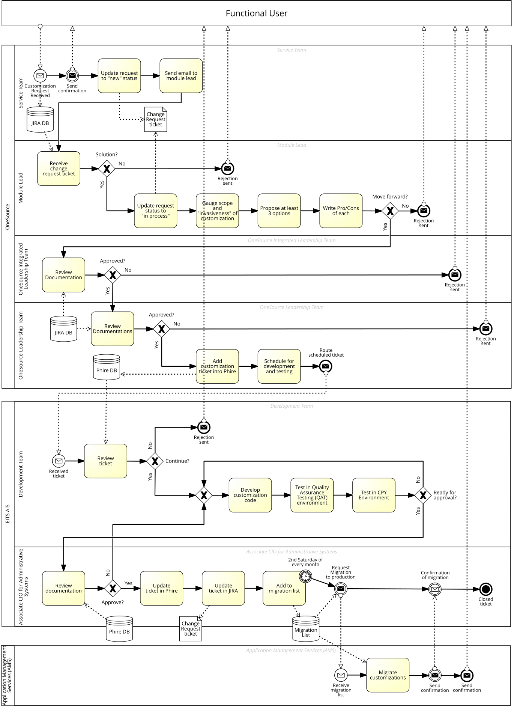
As-Is Model

Slide 7
As-Is Model

Slide 8
As-Is Model

Slide 9
Potential Issues in the Process
Unknown cycle time for the process
No KPIs (Key Performance Indicator) for the process
  Evaluate success at reaching targets: Cycle Time
Manual input by financial lead for change requests into JIRA DB
Lack of integration between JIRA and PHIRE
Multiple level of approvals that can cancel the request
All related processes must go through end to end testing after upgrade or code change

Slide 10
To Be Continued...

Slide 11
Recommendations
Allow Development Team Leader to have input in OneSource Leadership Team
Send customer estimated wait time on ticket request
Store everything into Phire database to eliminate JIRA database

Slide 12
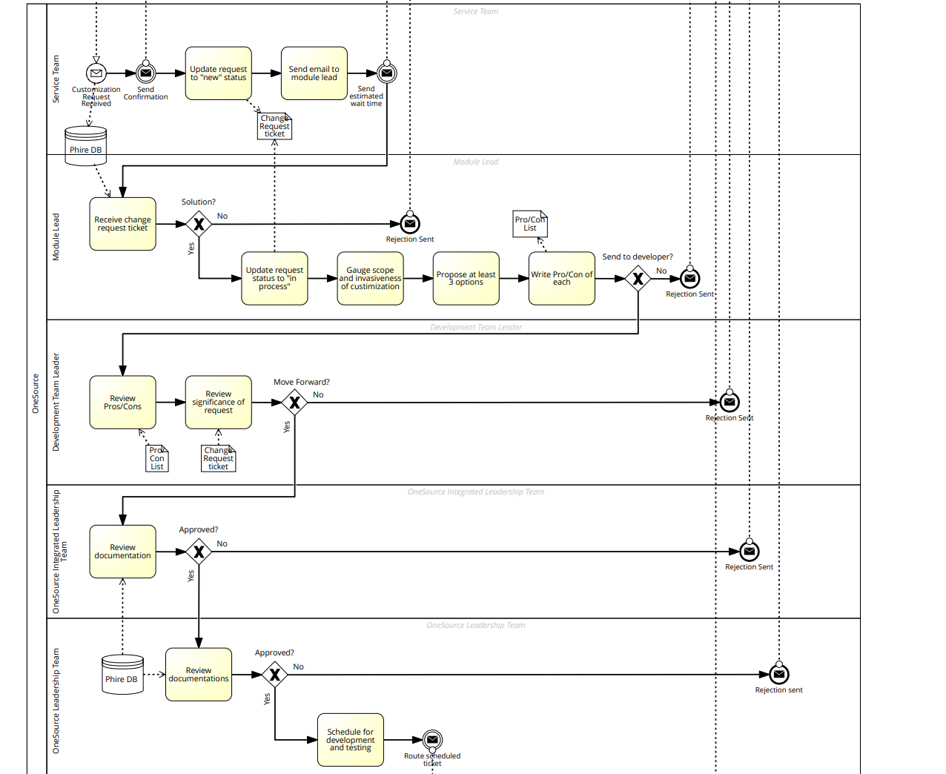
To-Be Model

Slide 13
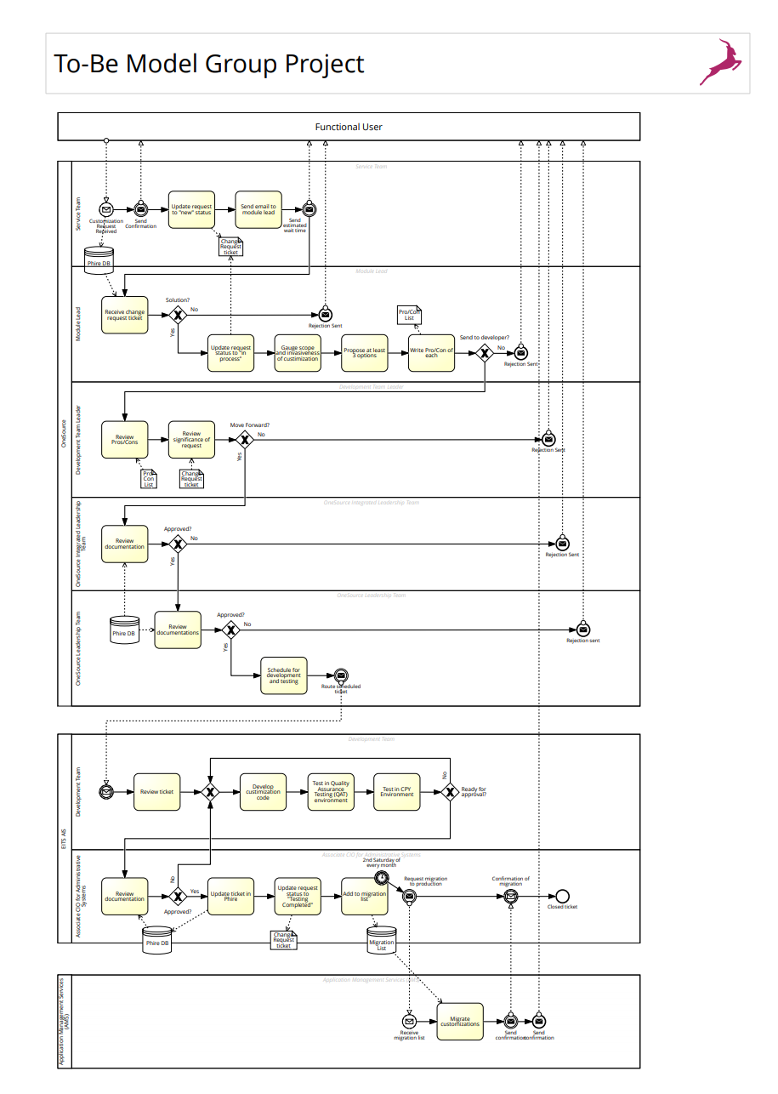
To-Be Model

Slide 14
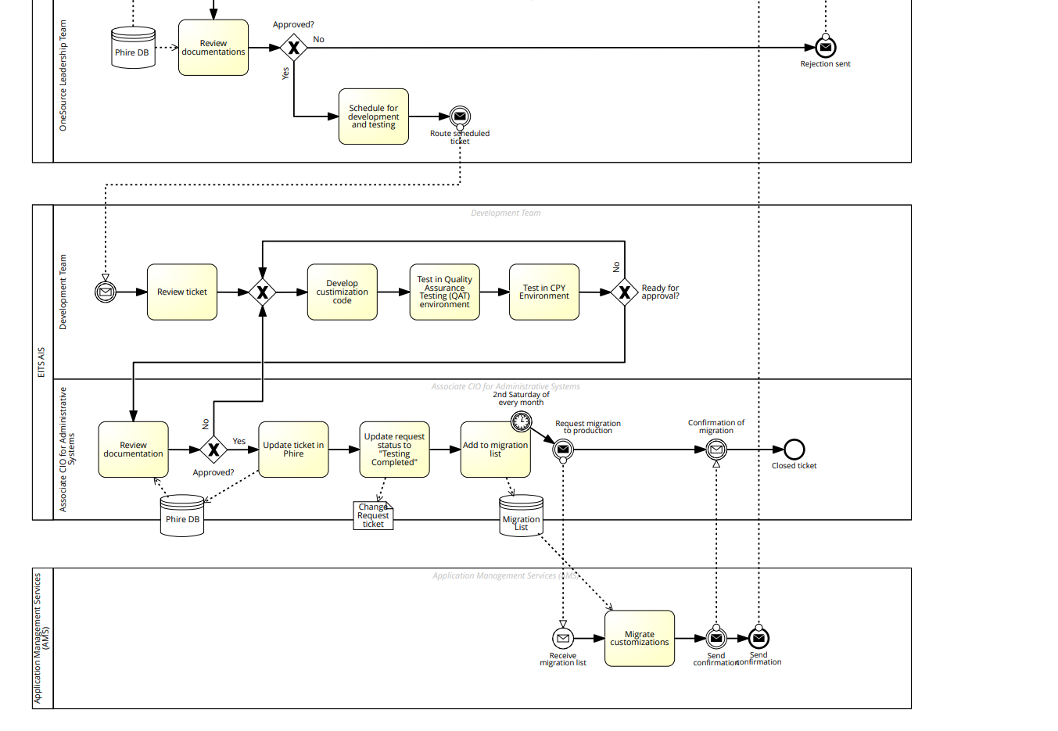
To-Be Model

